Slide 1
INFORMATICA MDM INSTALATION

Slide 2
AGENDA
Pre-Requisites to Install MDM
Database Environment Setup
Application Server environment setup
Installation steps
Post Installation tasks and validation

Slide 3
STEPS
Data Base Install→ Jboss/ App Server Install→ Hub Store(Inc. ActiveVOS) → Hub Server(Inc. ActiveVOS) → Process Server → RESOURCEKIT

Slide 4
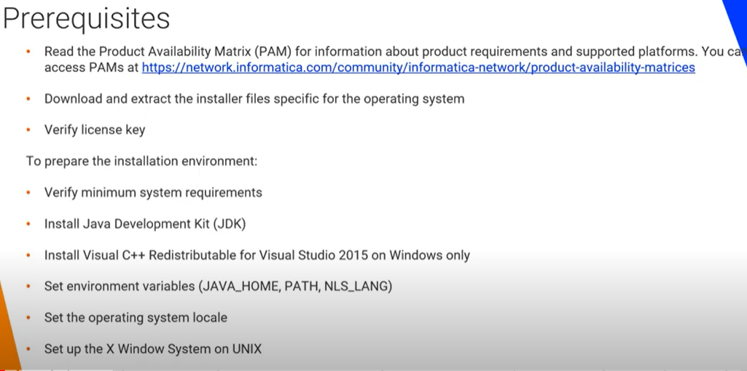

Slide 5
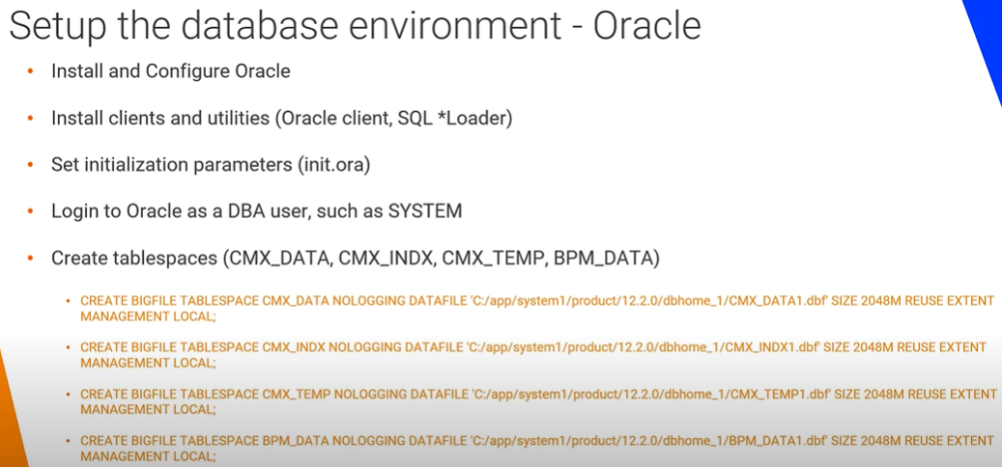

Slide 6
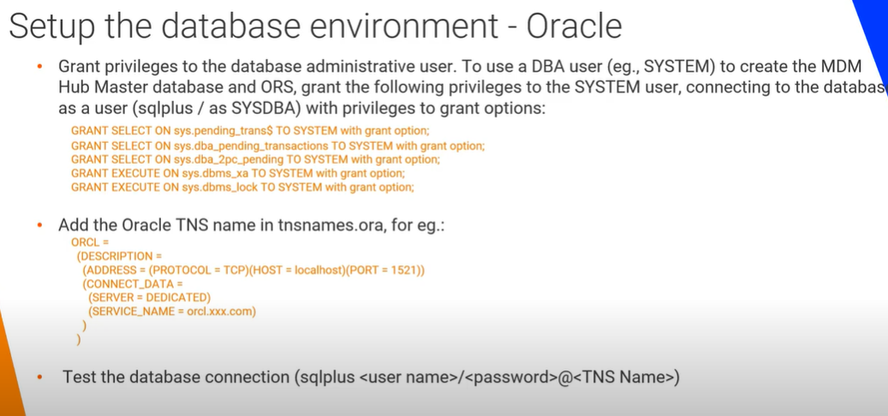

Slide 7
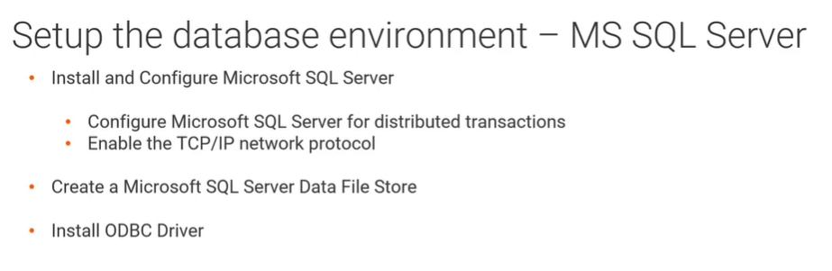

Slide 8
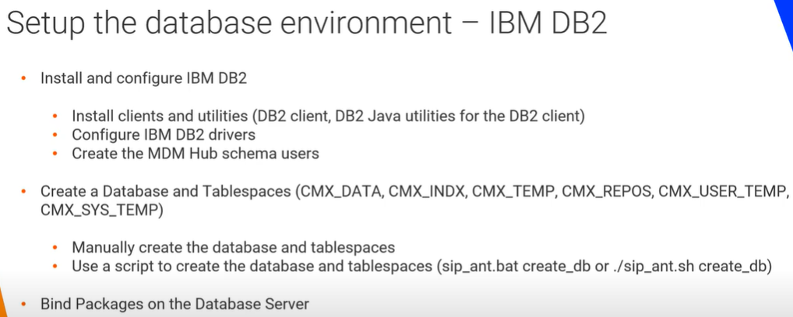

Slide 9
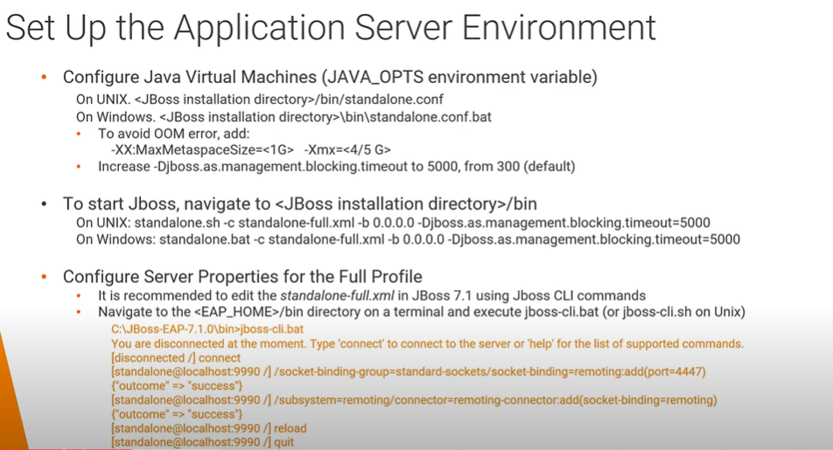

Slide 10
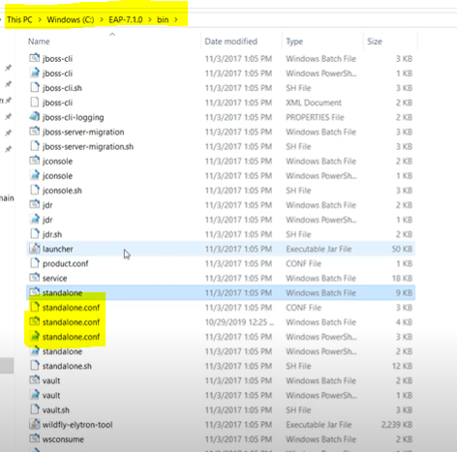
Jboss → Bin Folder where you will get standalone.conf file.

Slide 11
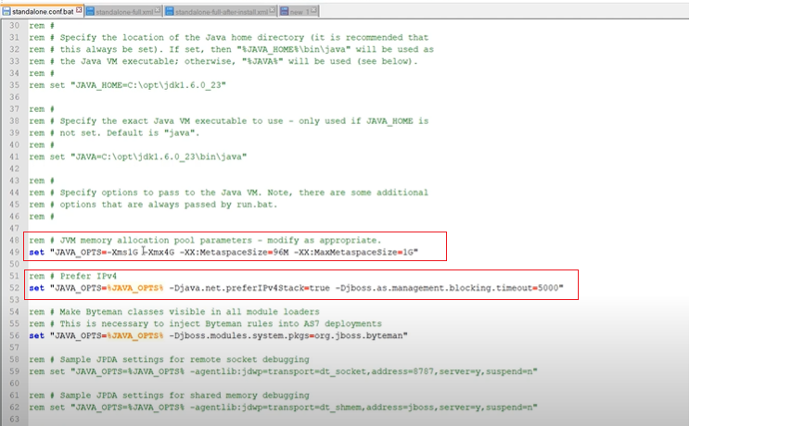
Increase Memory Size to avoid OOM issue
Increases TimeOut value, to avoid deployment delay issue.

Slide 12
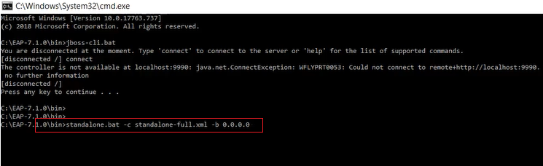
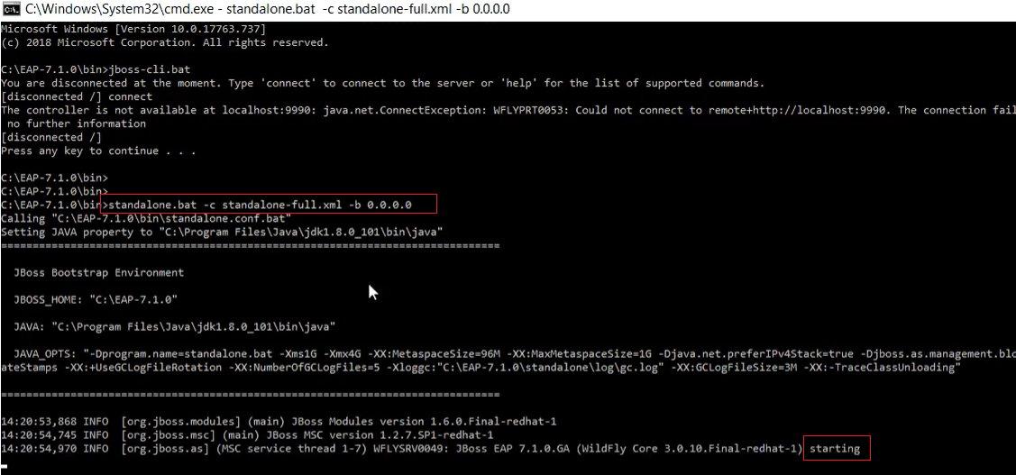
TO Start JBoss

Slide 13
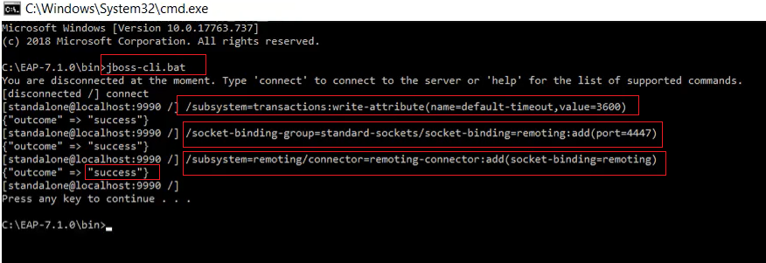
Increase MDM Transaction Time Out
This is to connect Hub Console through Remote Machine

